Slide 1
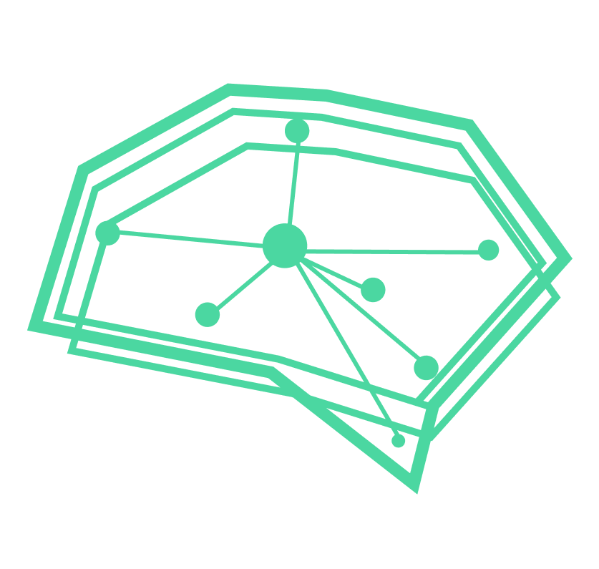
VoxelBox Processing Pipeline

Slide 2
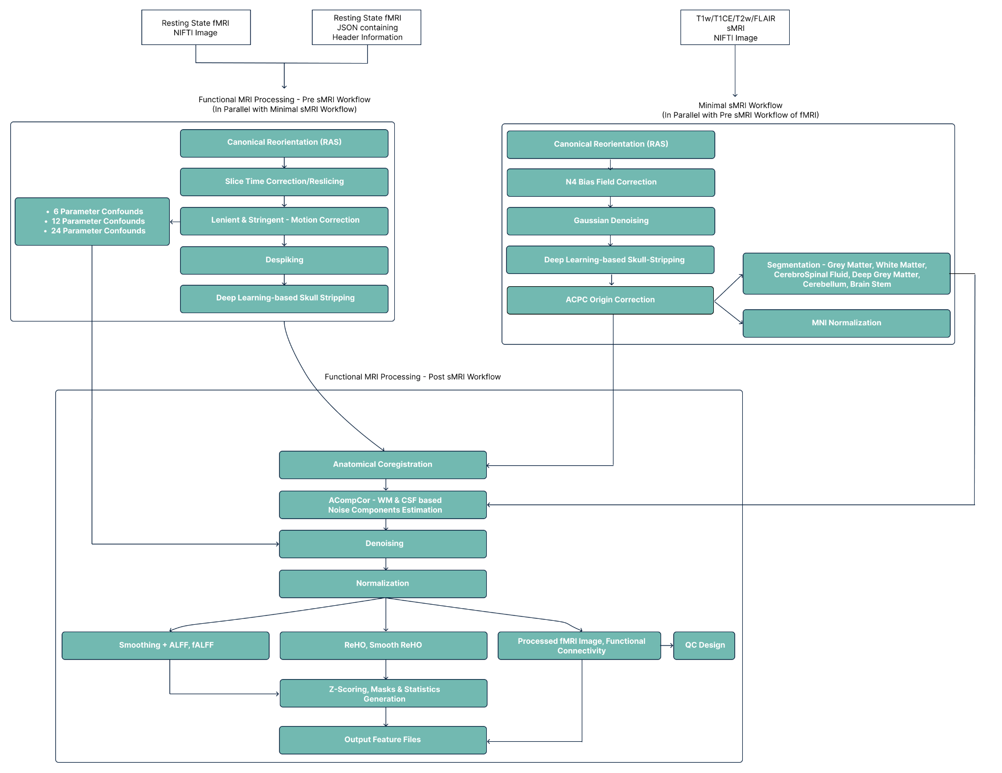
rs-fMRI Processing Pipeline
Notes:
]

Slide 3

Slice Time Correction
Slice Timing Correction is used to compensate for the time differences between the slice acquisitions by temporally interpolating the slices so that the resulting volume is close to equivalent to acquiring the whole brain image at a single time point.
Notes:
]

Slide 4
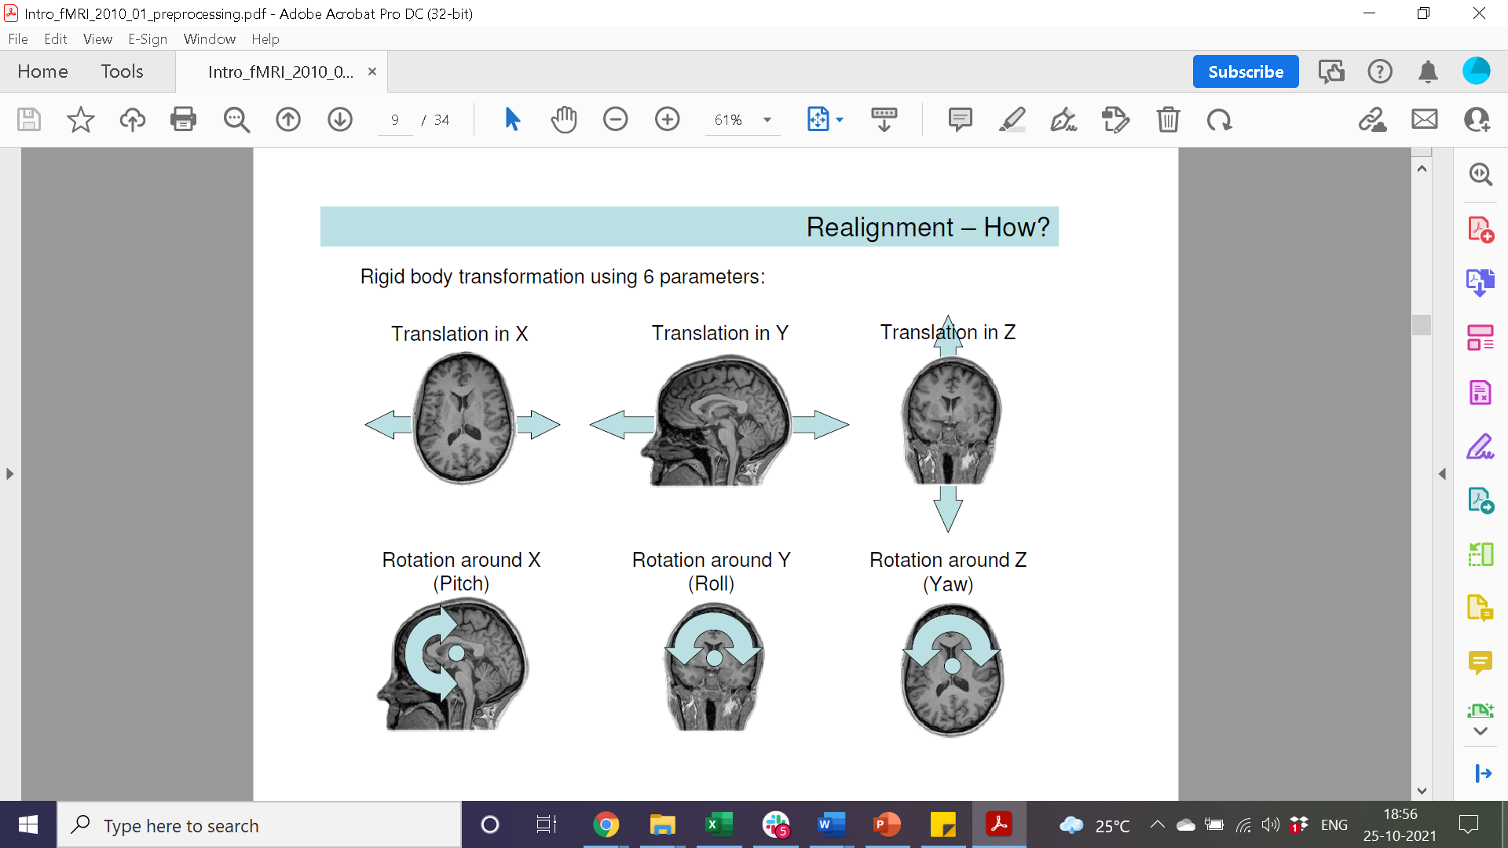
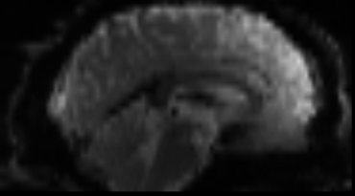
Motion Correction
Motion correction, also known as Realignment, is used to correct for head movement during the acquisition of functional data. Head movement can be characterized by six parameters: Three translation parameters which code movement in the directions of the three-dimensional axes, movement along the X, Y, or Z axes; and three rotation parameters which code rotation about those axes, rotation centered on each of the X, Y, and Z axes).
Further, first and second order derivatives are derived for each 6 parameters as suggested by Friston et al. to regress motion confounders: https://sci-hub.se/https://pubmed.ncbi.nlm.nih.gov/8699946/
Notes:
]

Slide 5
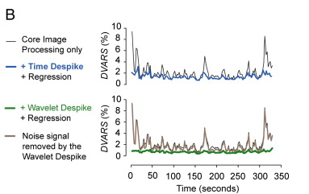
Despiking
Despiking is a process in which large spikes in the fMRI times series are truncated. This limits the magnitude of data spikes as the amplitude is reduced
Notes:
]

Slide 6
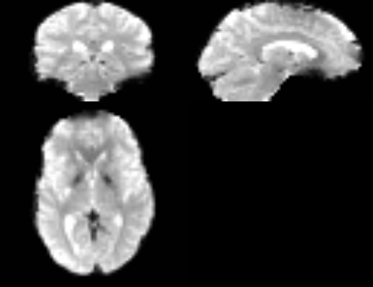
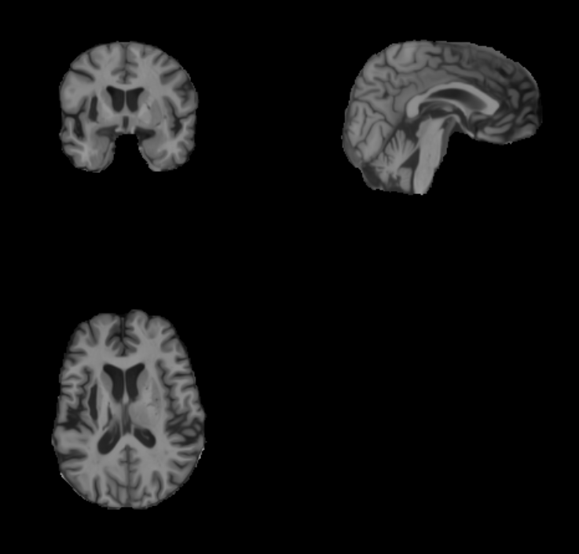
Skull-Stripping
Skull stripping of T1w MRI and rs-fMRI improves the robustness of the coregistration and MNI normalization. We use a deep learning based approach for skull-stripping using UNET3D architecture.
Reference: Skull stripping - UNET3D SkullStrip: https://www.nature.com/articles/s41598-021-87564-6
Notes:
]

Slide 7
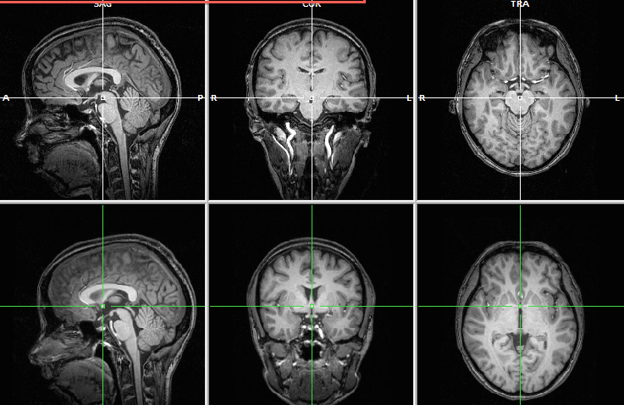
ACPC Origin Correction
Automatic ACPC Origin Correction -
The sMRI and fMRI might have different origins in the 3D space which can lead to incorrect registration of the slices in the image. To avoid this, we perform automatic ACPC origin correction using SPM12 coregister estimate which estimates the origin to be set in the given MRI by comparing it with a manually ACPC origin corrected template.
Notes:
]

Slide 8
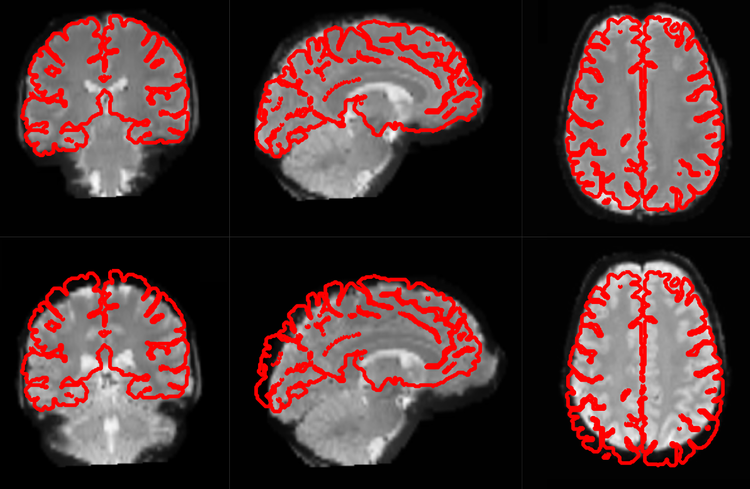
Coregistration
Coregistration tries to superimpose the functional image perfectly on the anatomical image. This allows further transformations of the anatomical image, such as normalization, to be directly applied to the functional image.
We perform “Rigid” transformation with “Mutual Information” metric for coregistering functional image the anatomical image.
Notes:
]

Slide 9
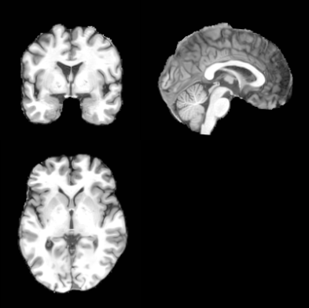
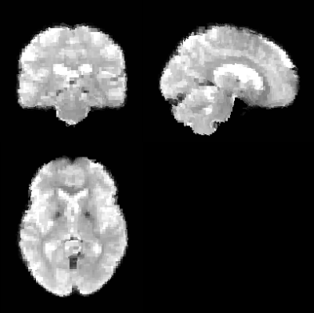
Normalization - Coregistration with Reference Template
Normalization maps data from the individual subject-space it was measured in onto a common/reference-space using templates like MNI152.
We apply “Rigid” transformation with “Mutual Information” metric for normalizing the functional image to MNI152 image’s space at 2mm³ isotropy.
MNI Normalized T1w
MNI Normalized fMRI
Notes:
]

Slide 10
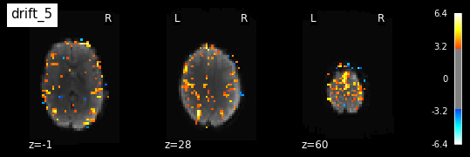
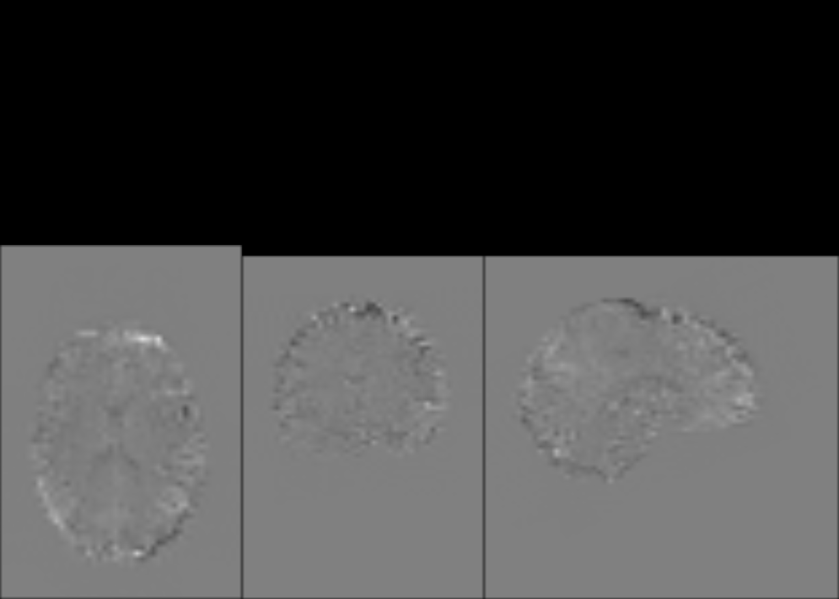
Denoising
We regress noise/nuisance signals/confounders using GLM (General Linear Model) to denoise rs-fMRI based on:
Friston24 Motion Confounder Parameters - https://pubmed.ncbi.nlm.nih.gov/8699946/
Component based Noise Correction (CompCor) - https://www.ncbi.nlm.nih.gov/pmc/articles/PMC2214855/
rs-fMRI is detrended (quadratic) and Band-pass filtered (0.01 Hz - 0.1 Hz) during denoising.
Confounders
Denoised fMRI
Notes:
]

Slide 11
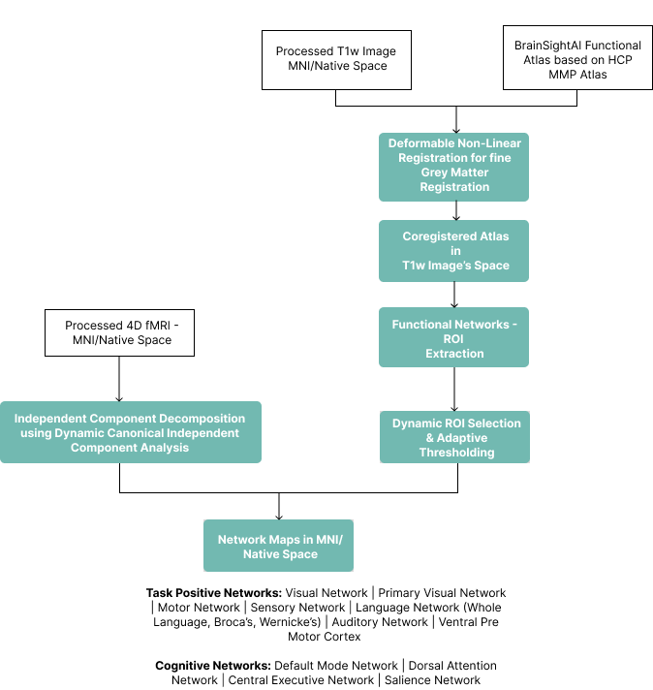
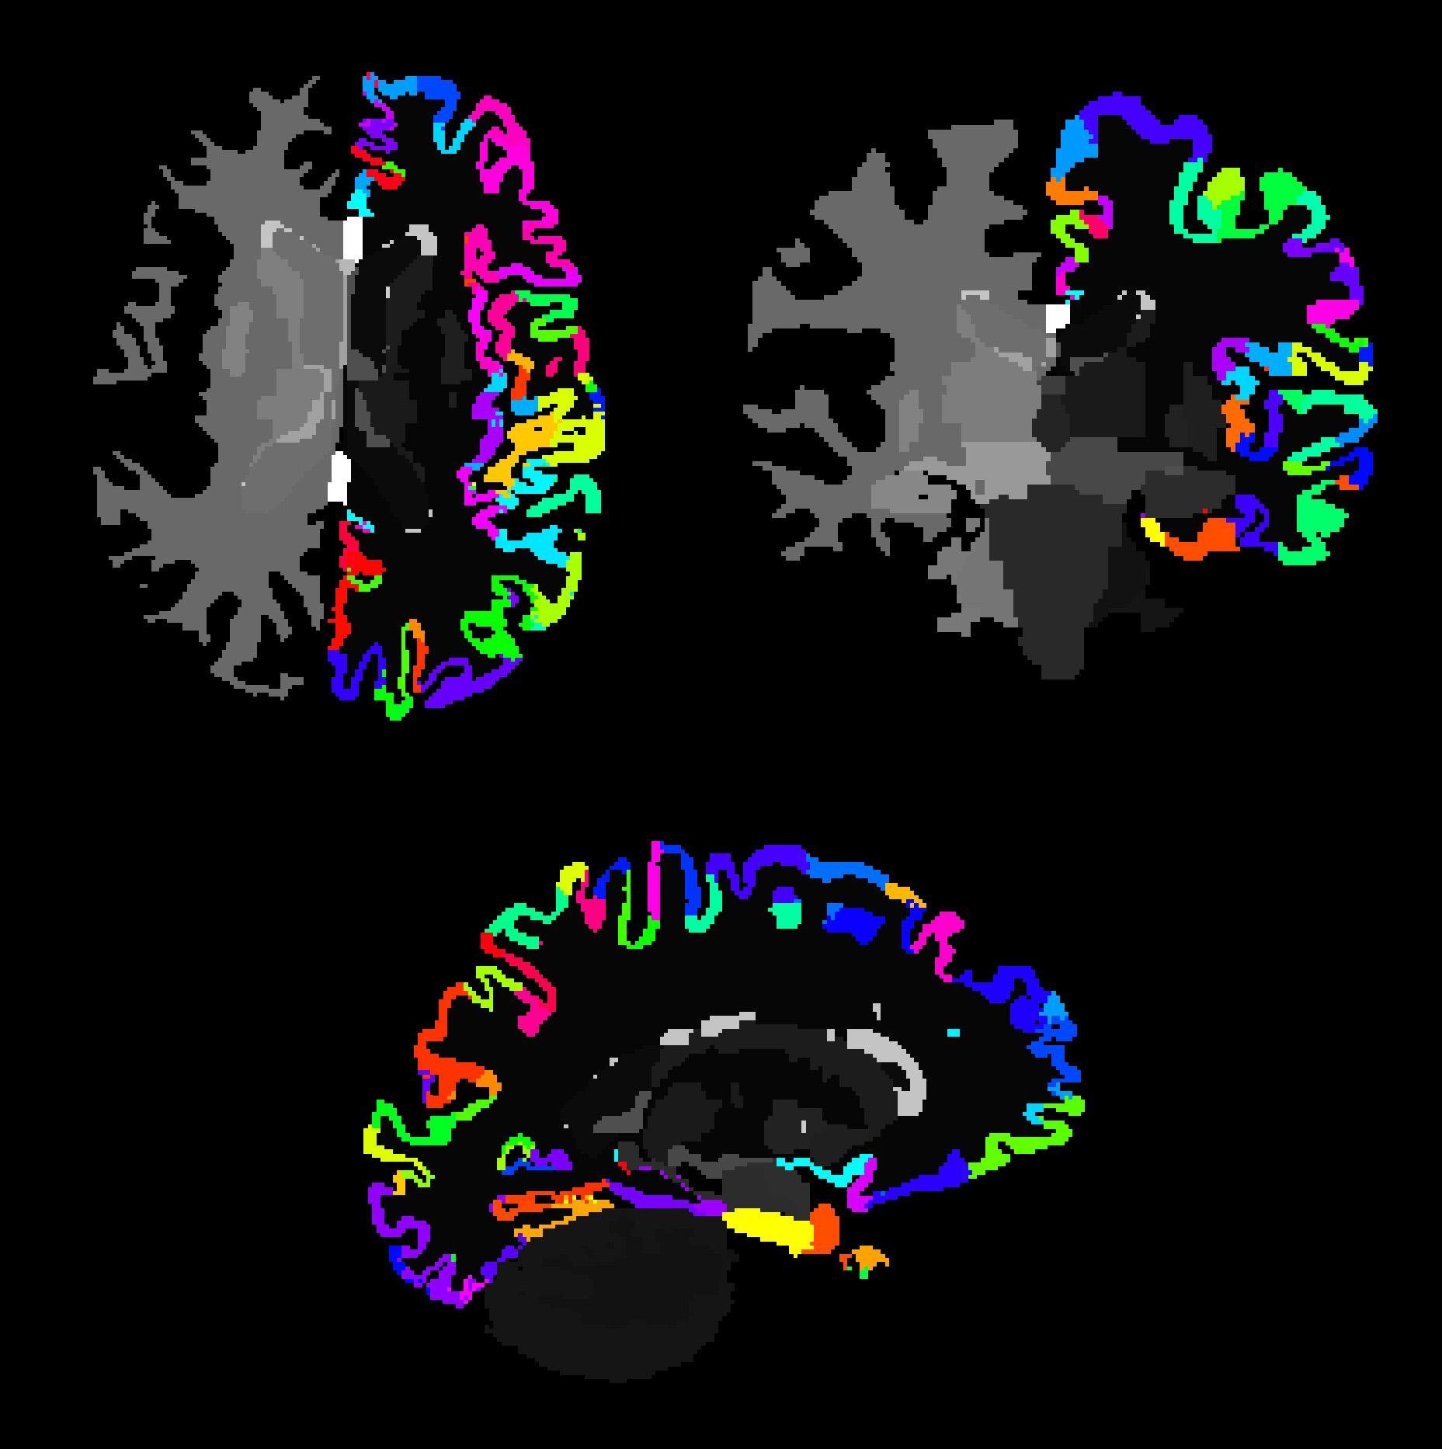
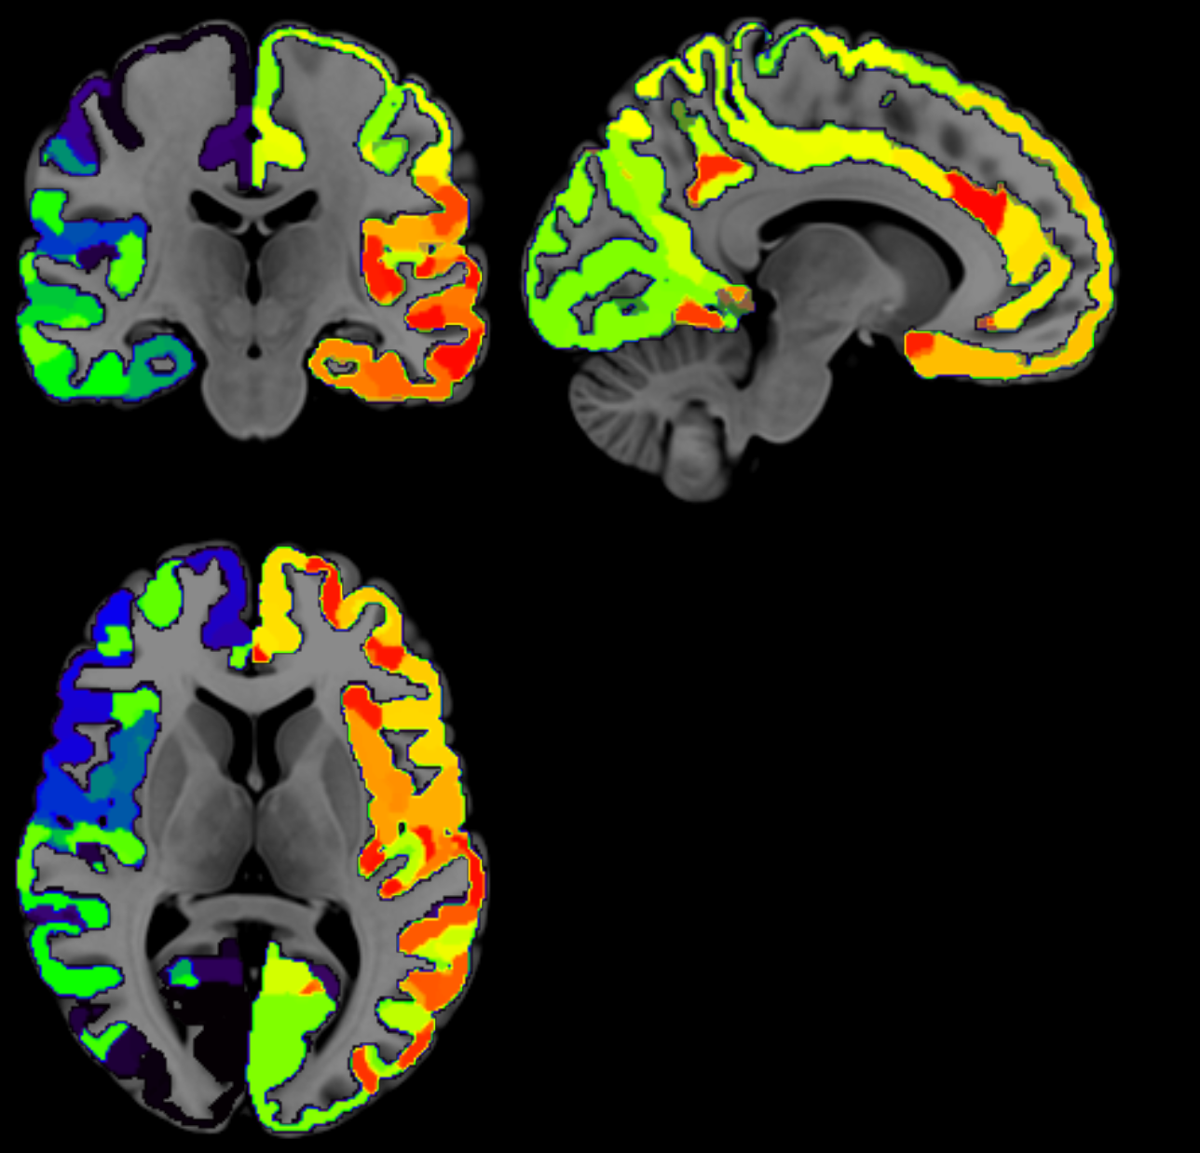
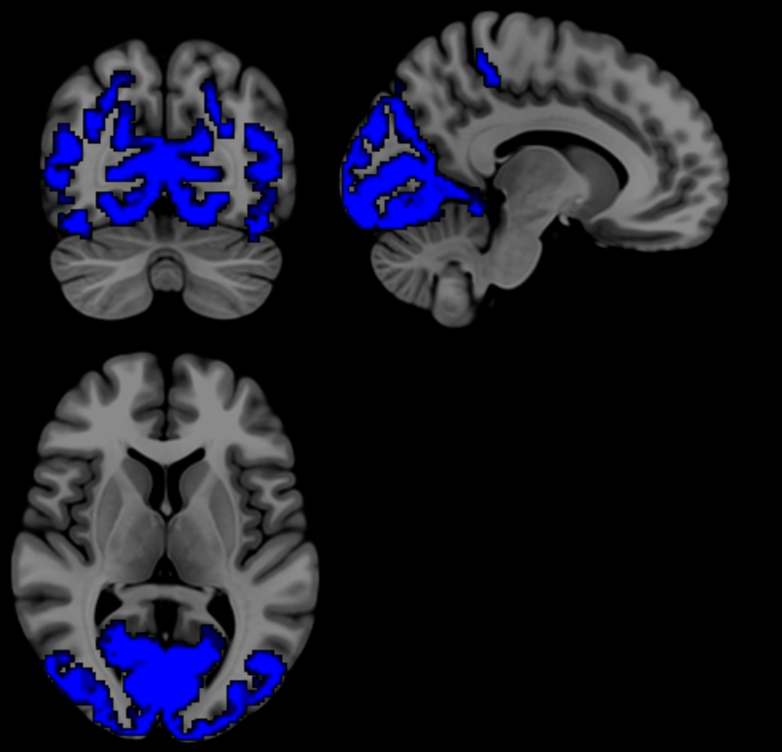
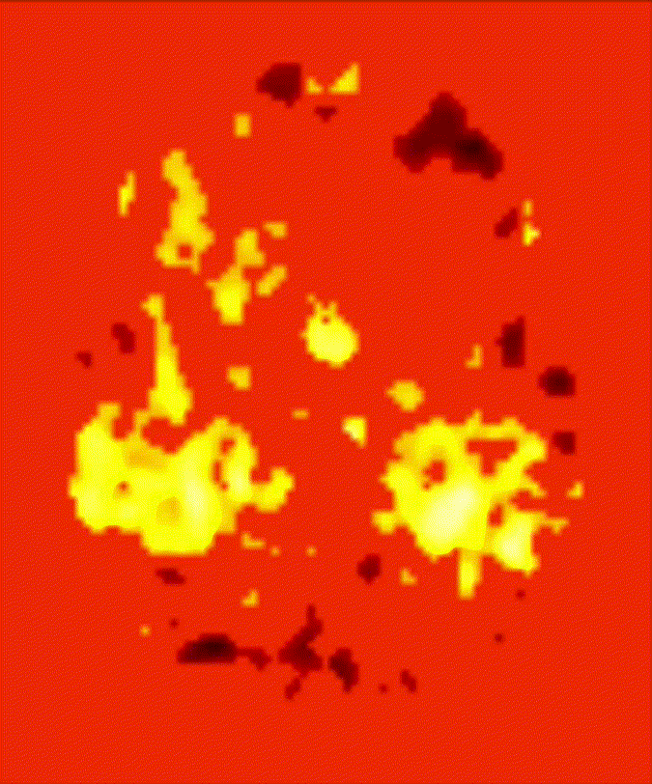
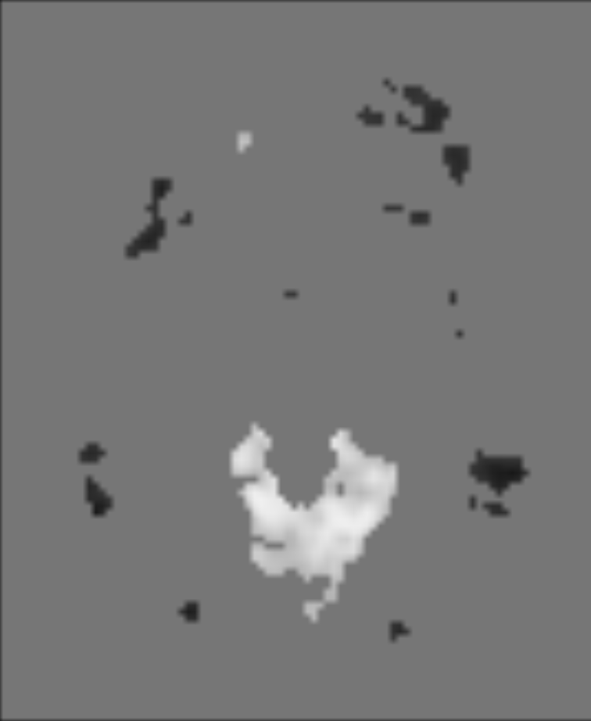
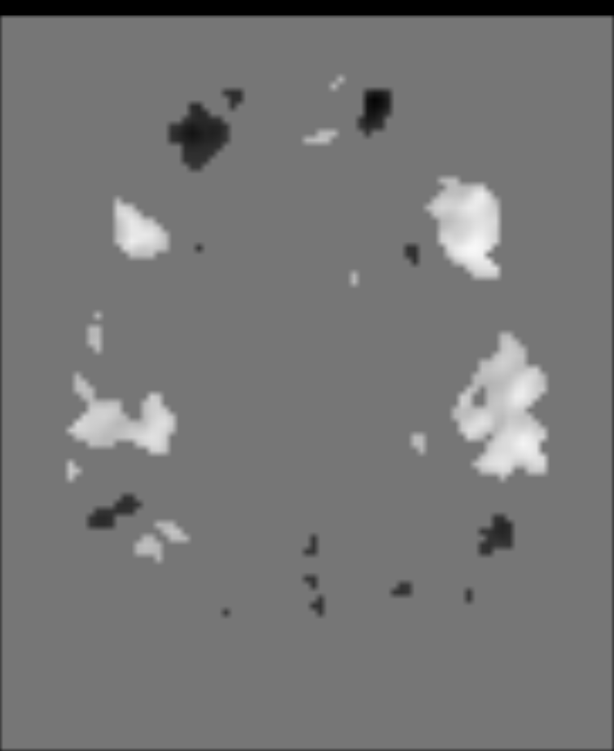
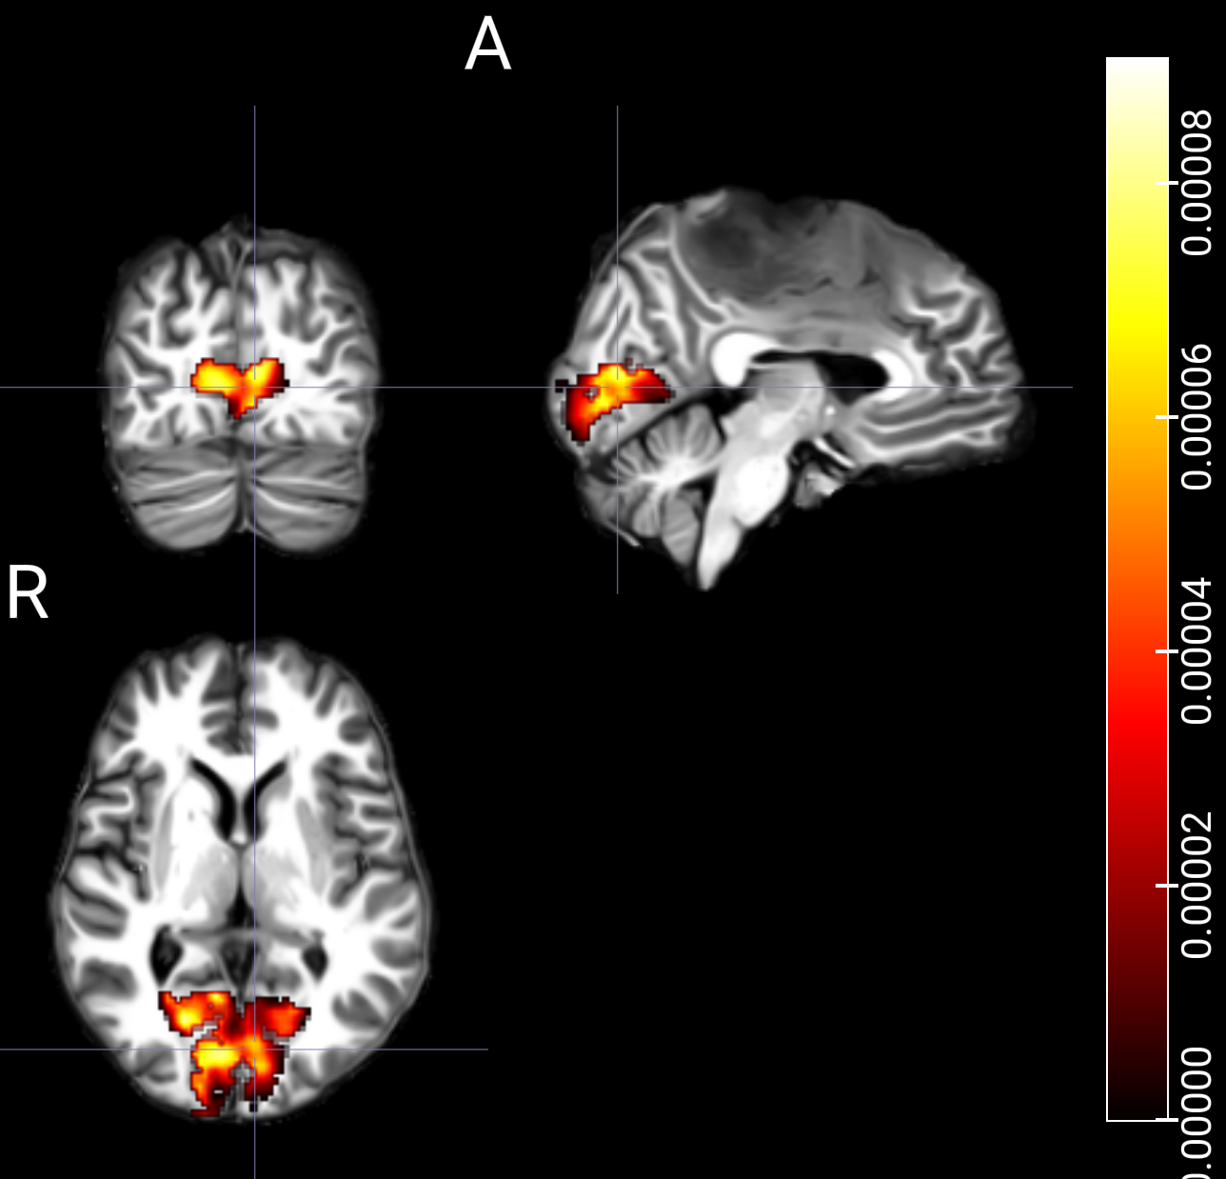
Network Mapping
IC components
Visual
Ex: Independent Components Matching Primary Visual and Language Networks

Slide 12
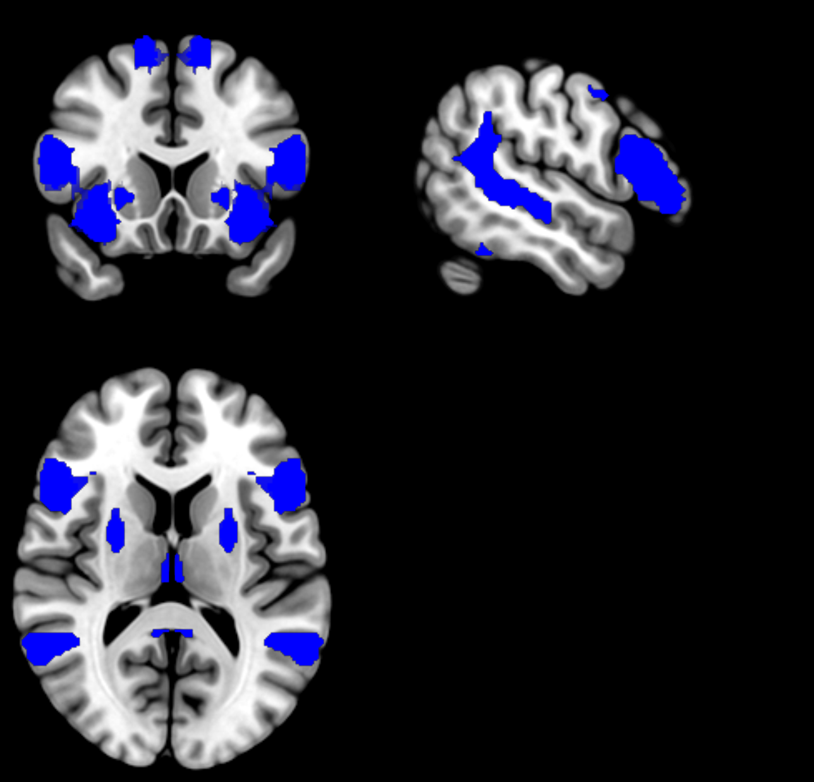
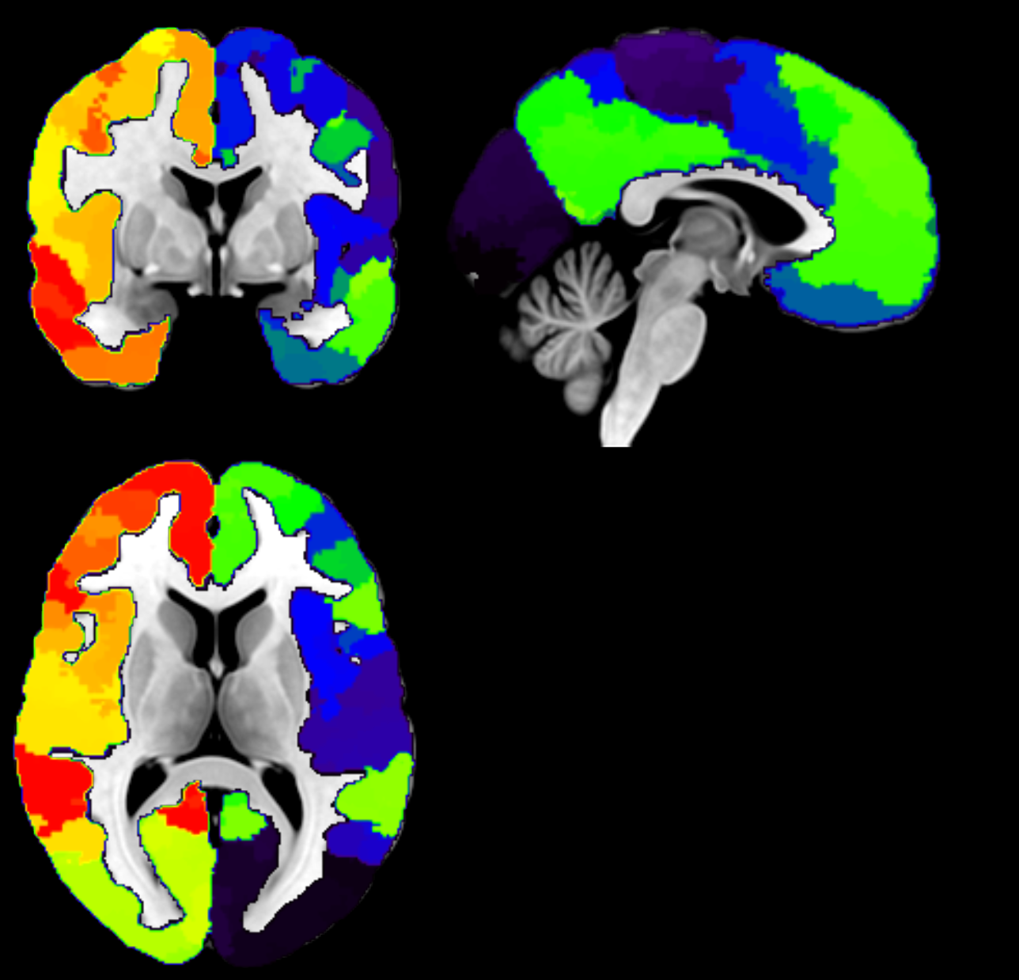
Network Mapping - Atlases
HCP MMP Atlas
(from tb fMRI and rs fMRI of
1200 healthy young adults )
SENSAAS Language Atlas
(from 144 healthy young adults performing language tasks)
Schaefer Atlas
(from rs-fMRI data of 1489 young adults)
References:
HCP MMP: https://www.ncbi.nlm.nih.gov/pmc/articles/PMC4990127/
SENSAAS: https://link.springer.com/article/10.1007/s00429-018-1810-2
Schaefer atlas: https://pubmed.ncbi.nlm.nih.gov/28981612/

Slide 13
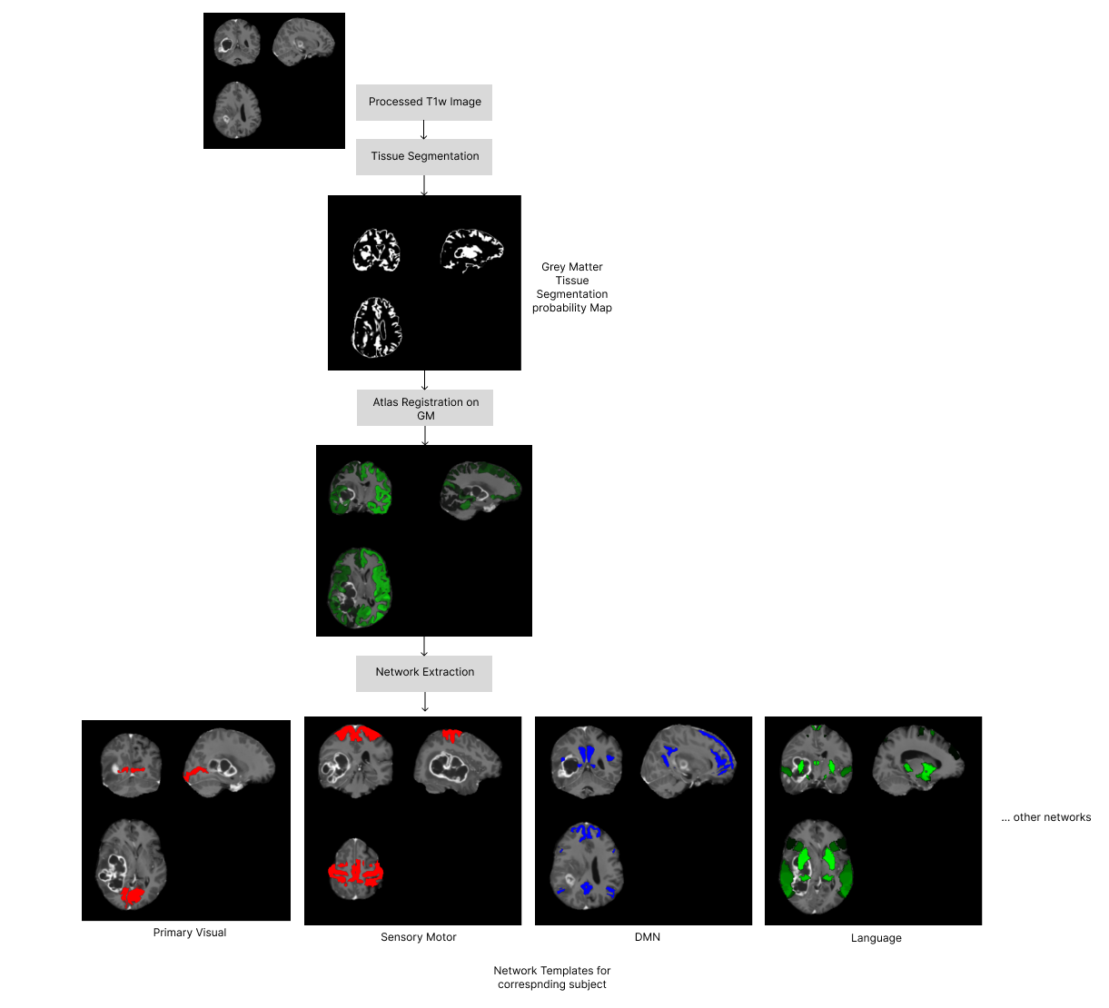
Network Mapping
Notes:
]

Slide 14
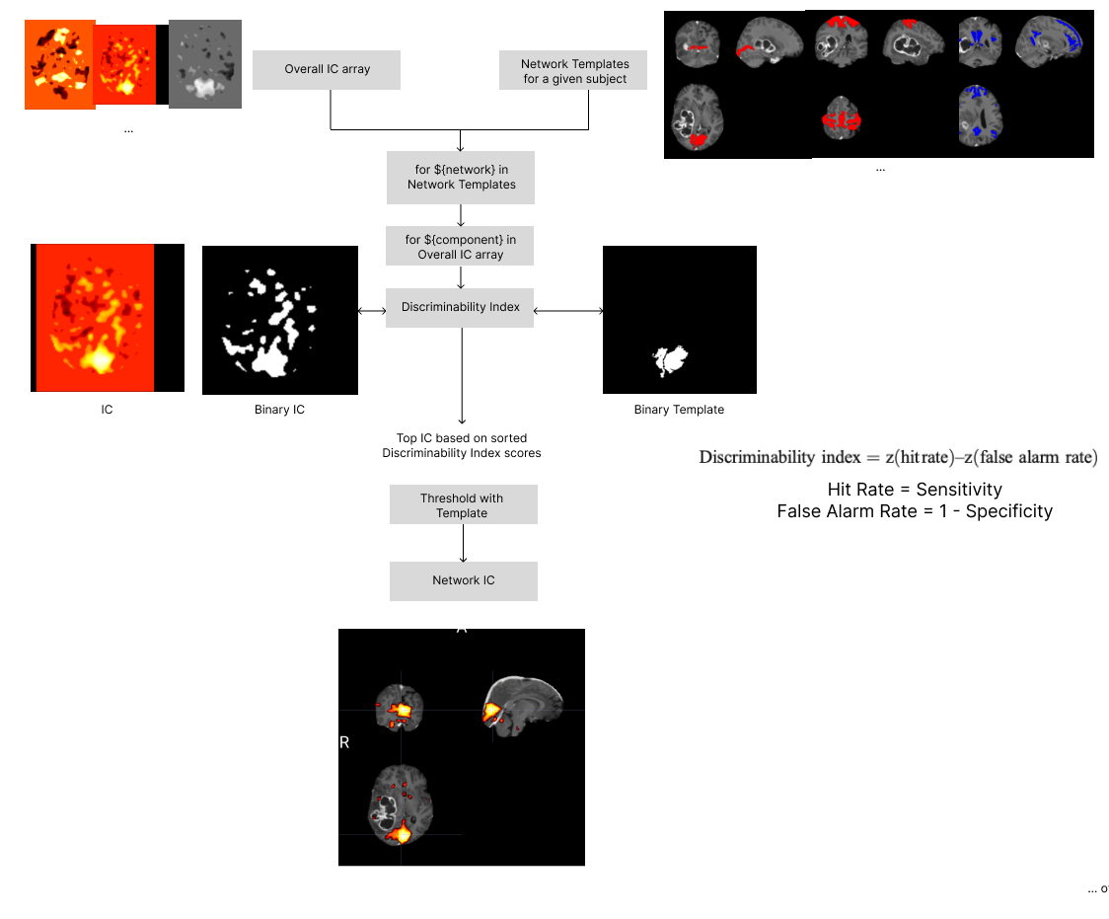
Network Mapping
Notes:
]

Slide 15
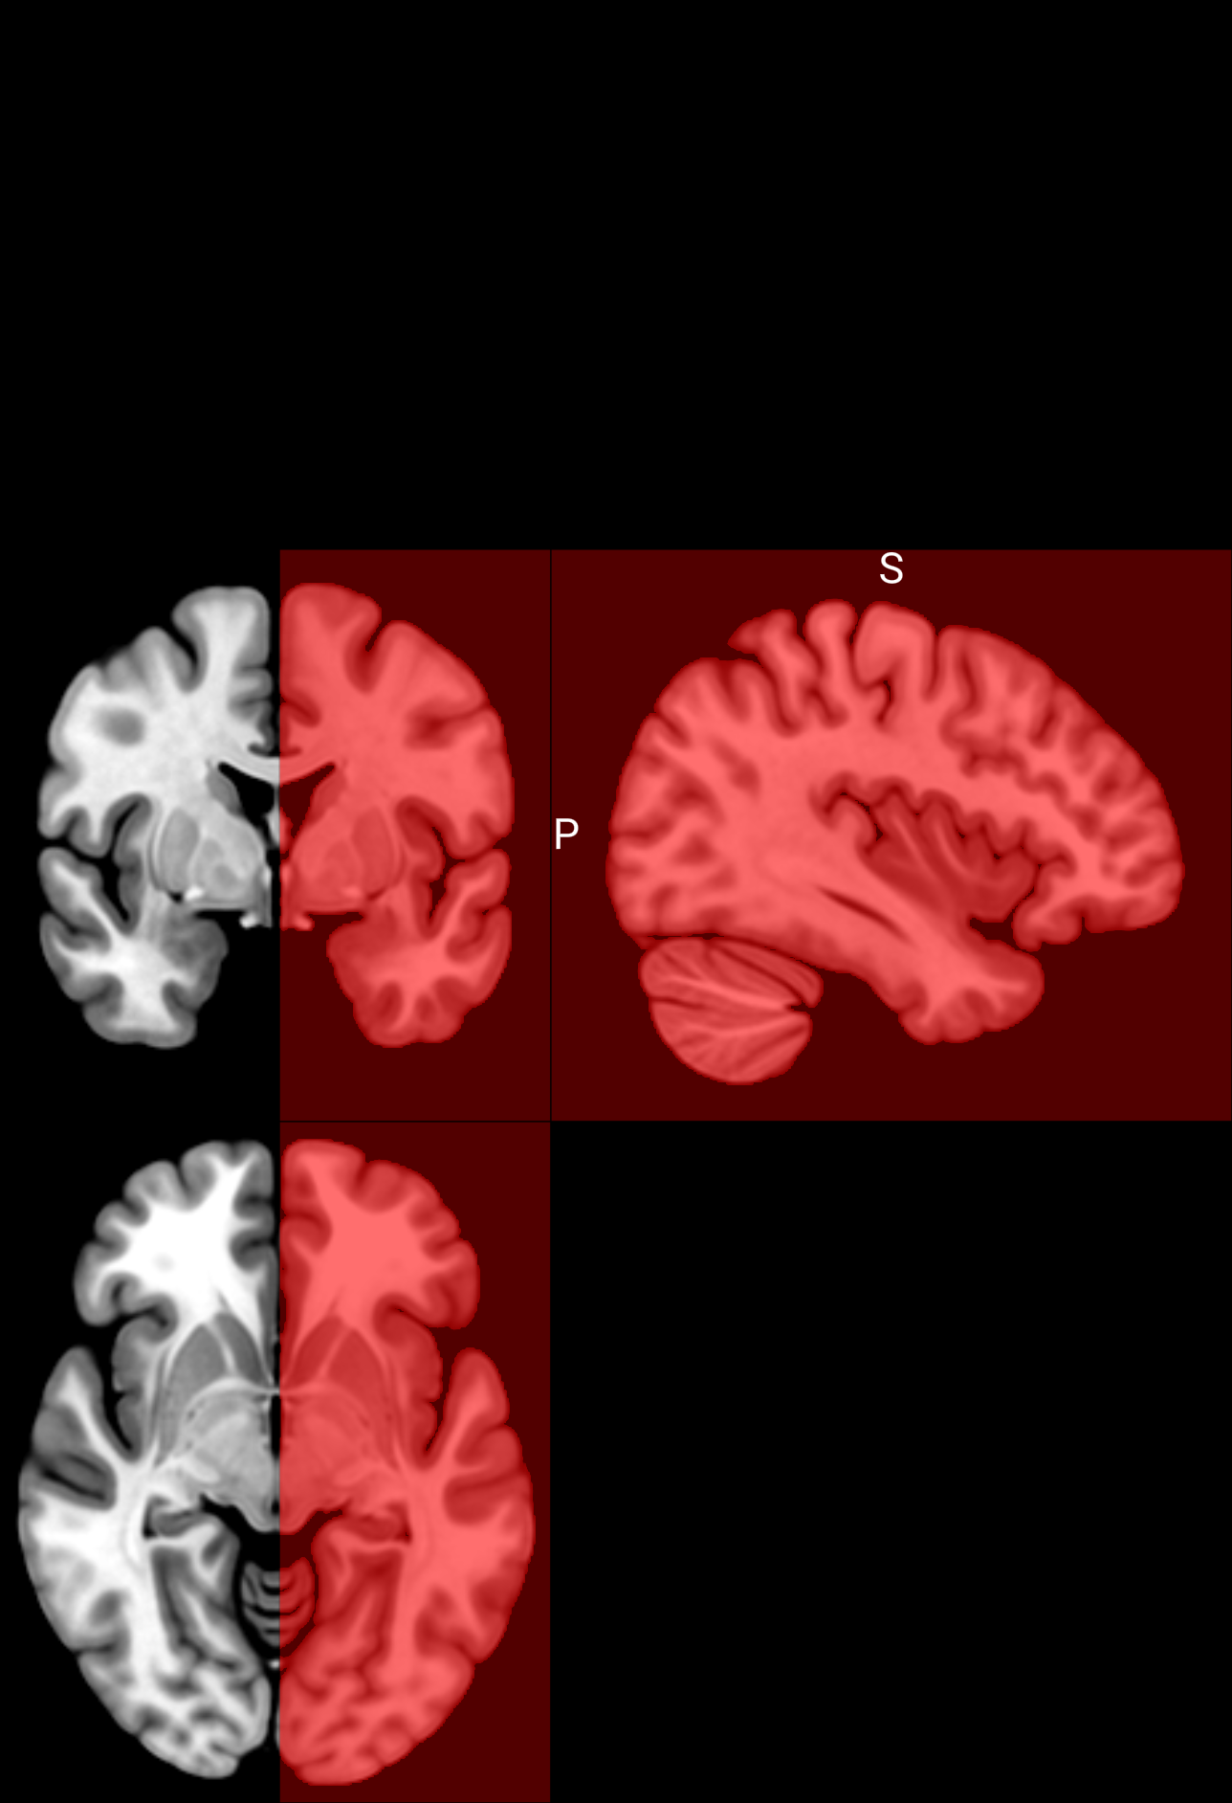
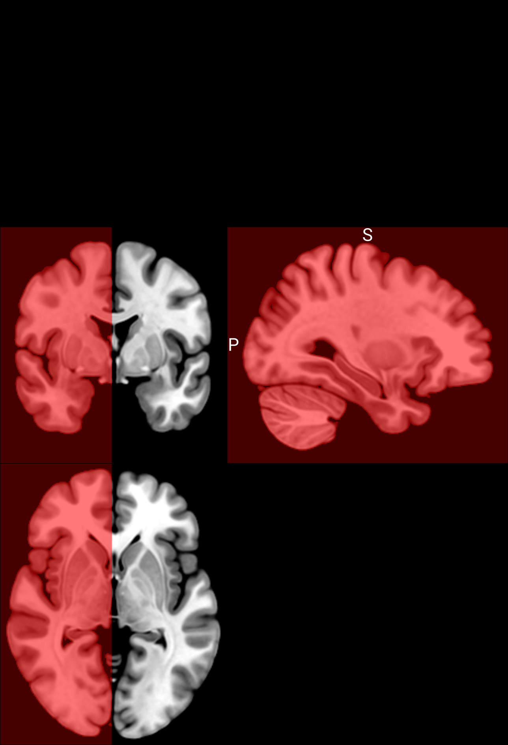
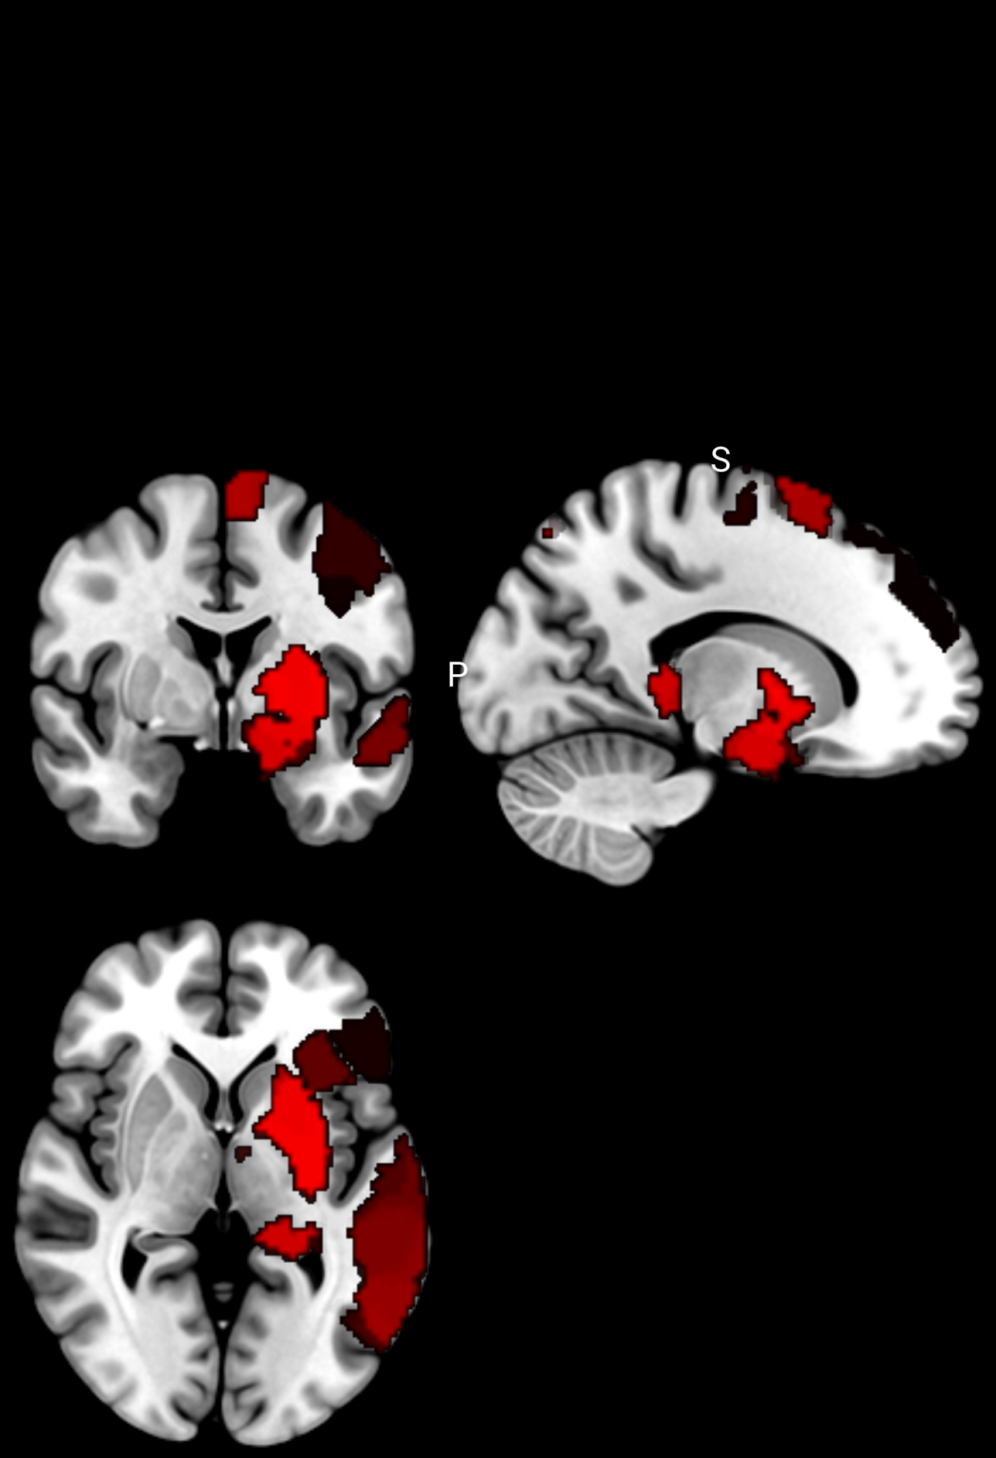
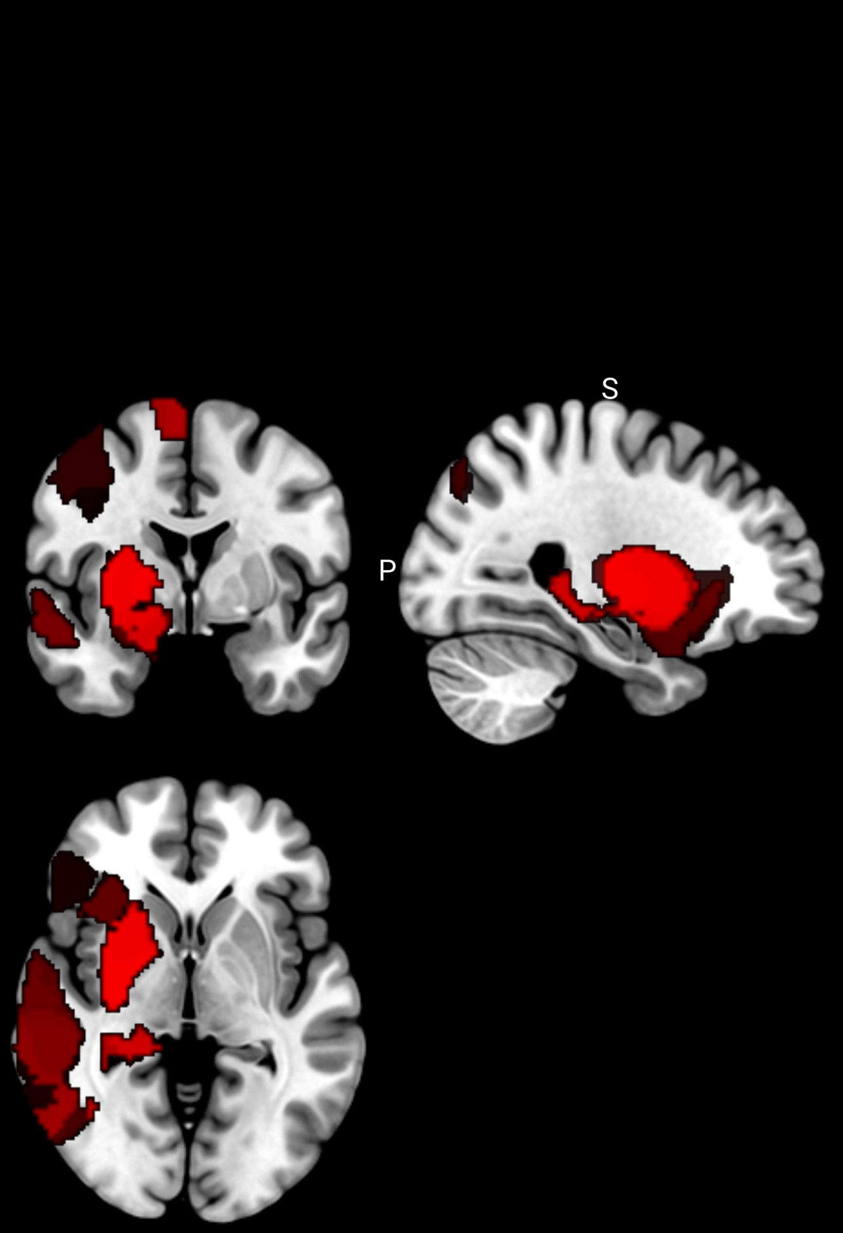
Network Mapping - Language Lateralization
Mask activations in Left Hemisphere using Left Hemisphere mask
Mask activations in Right Hemisphere using Right Hemisphere mask
Language - Left Hemisphere
Language - Right Hemisphere
Notes:
]

Slide 16
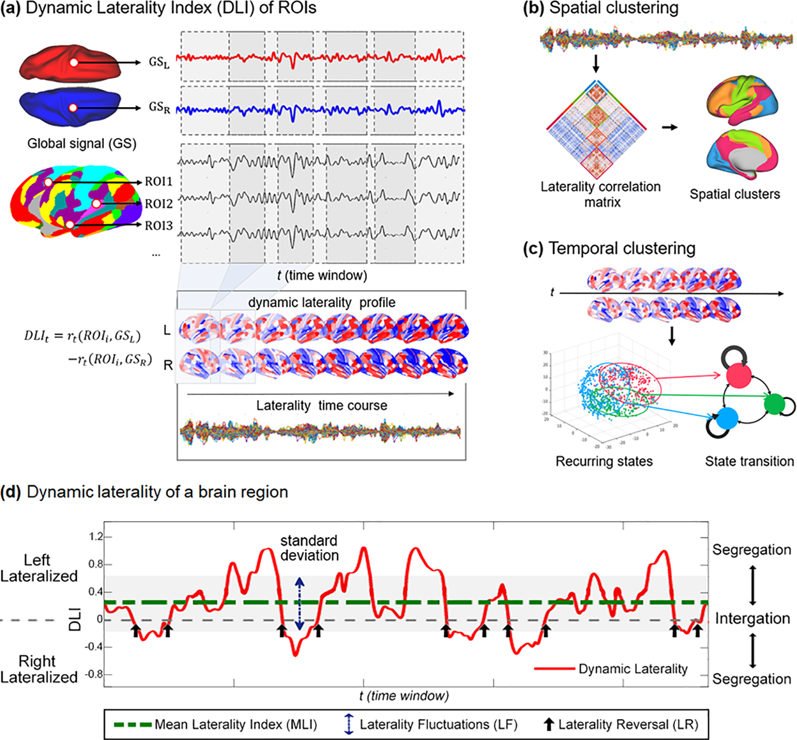
Network Mapping - Language Lateralization
Dynamic Laterality Index (DynLI)
Get Time-series of Language-related ROIs and calculate dynamic laterality index on the connectivity time series between both Left and Right hemispheres to quantify laterality based on connectivity association, integration, and segregation.
Notes:
]

Slide 17
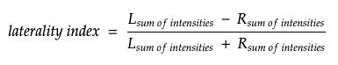
Network Mapping - Language Lateralization
Current Approach:
L_{sum of intensities} = Sum of all active voxel values from Left Hemisphere Language
R_{sum of intensities} = Sum of all active voxel values from Right Hemisphere Language
Notes:
]

Slide 18
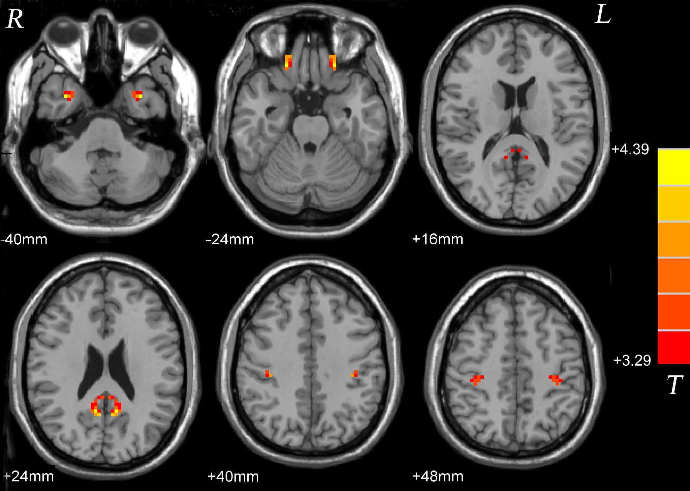
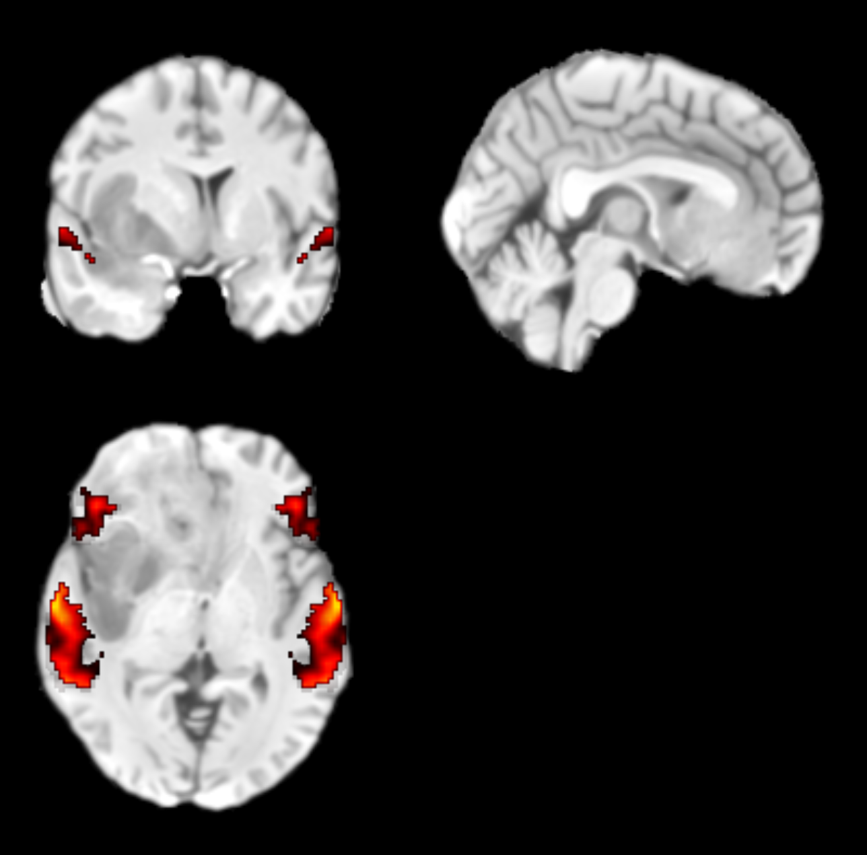
Network Mapping - Language Lateralization
Alternative Methods we’re looking into:
2. Voxel Mirrored Homotopic Connectivity (VMHC):
Voxel-mirrored homotopic connectivity (VMHC) is a method of rs-fMRI used to analyze functional homotopy between two hemispheres. The synchrony in patterns of spontaneous activity between homotopic regions in each hemisphere is an important feature of the functional structure of the brain. The VMHC is designed to directly compare the interhemispheric resting-state functional connectivity.
Notes:
]

Slide 19
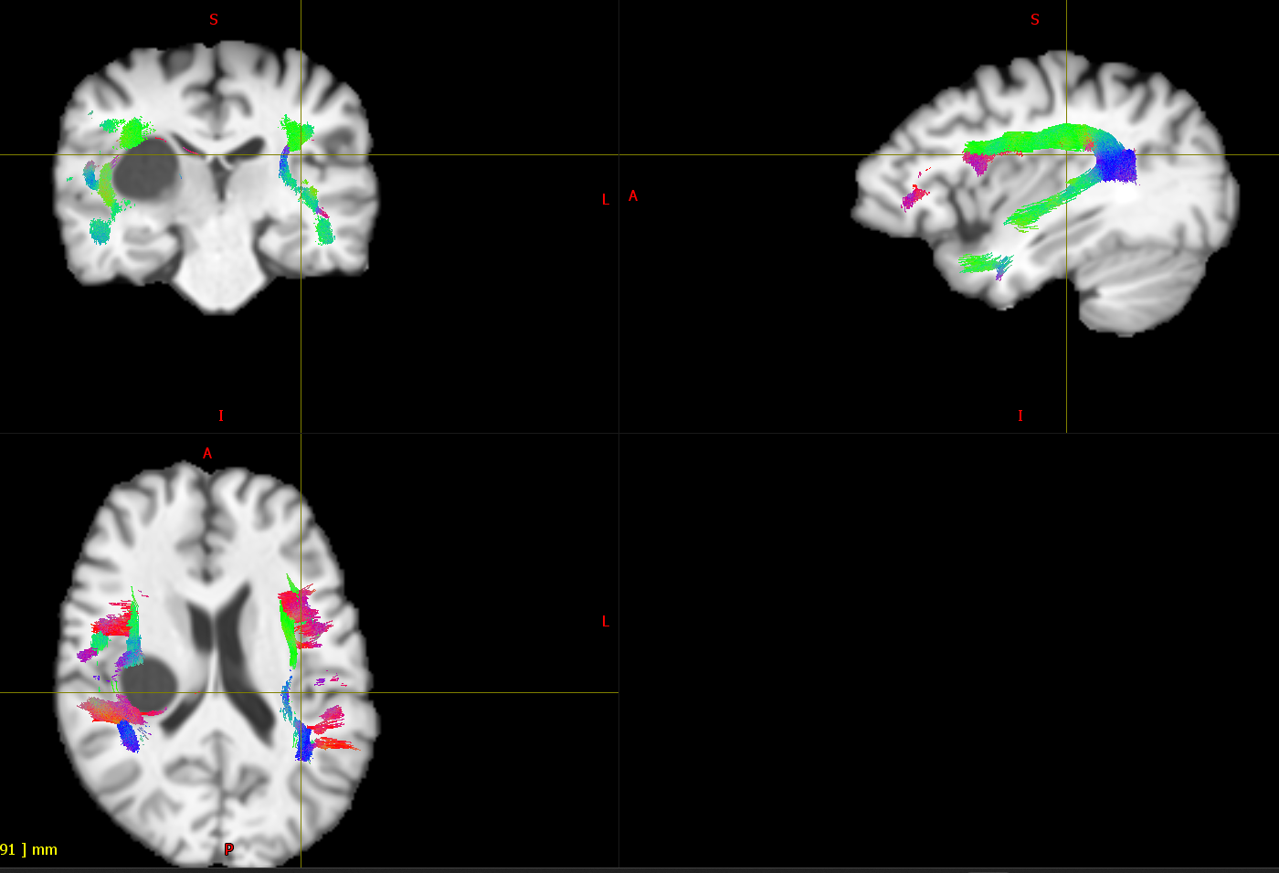
Network Mapping - Language Lateralization
Alternative Methods we’re looking into:
3. Arcuate Fasciculus Tract-based Lateralization:
Methods: 1. Number of Fibers/Fiber Count
2. Volume of Fibers
3. Density of Fibers
4. Fractional Anisotropy (FA) of Fibers
Notes:
]

Slide 20

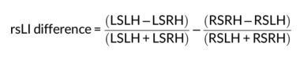

Network Mapping - Language Lateralization
Alternative Methods we’re looking into:
4. Inter and Intra-hemispheric Connectivity:
Lateralization based on intra-and-inter hemispheric connectivity of language related ROIs:
Notes:
]

Slide 21
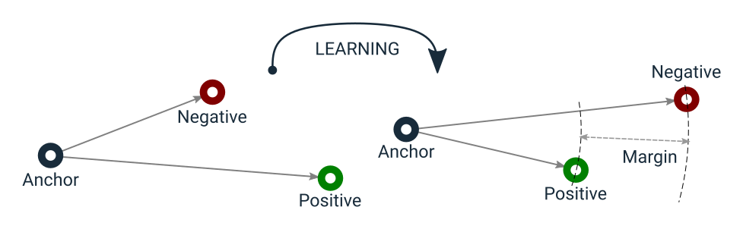
Network Mapping - Language Lateralization
Alternative Methods we’re looking into:
5. Machine Learning-based Connectivity Analysis for Lateralization:
Projecting connectivity features of Language-related ROIs to embeddings from which connectivity similarity can be used to derive lateralization.
Left Language Connectivity
Left Lateral
BiLateral
Language Connectivity
Right Language Connectivity
Right Lateral
Notes:
]

Slide 22
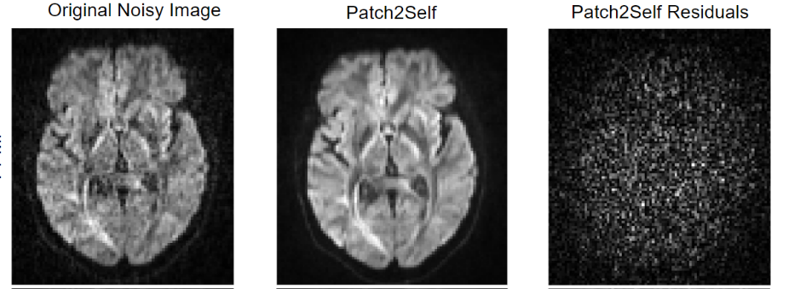
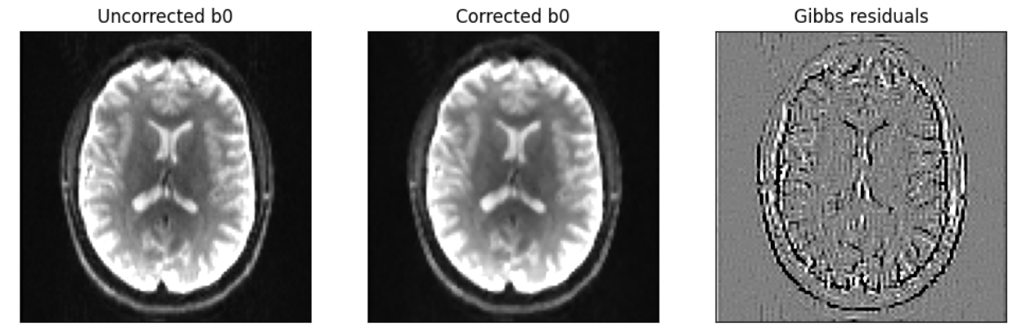
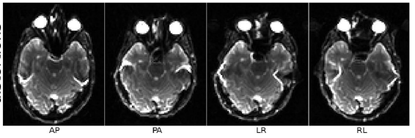
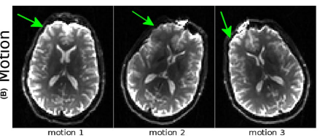
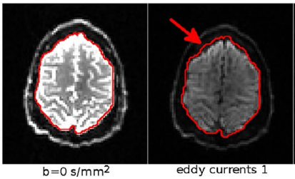
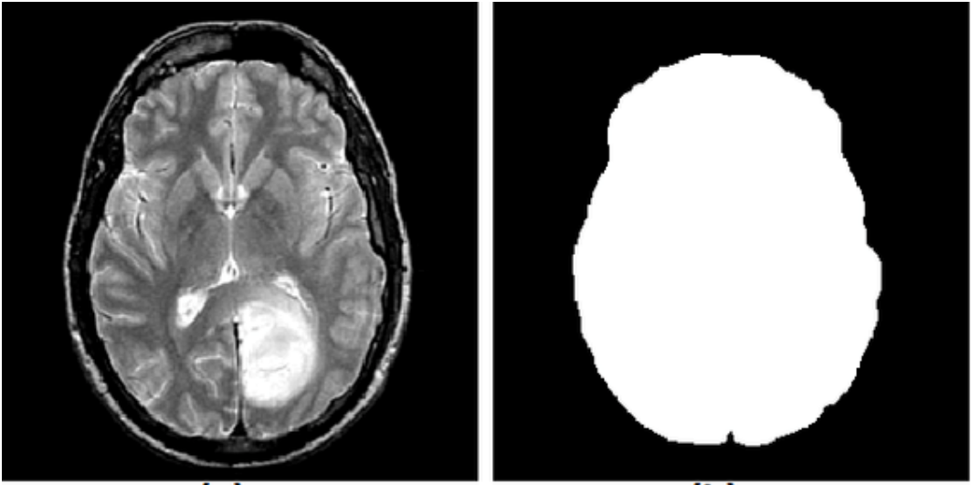
dMRI Processing
Denoising
Denoising
Removes Random noise, boosts SNR
Gibb’s correction
Removes Gibb’s ringing artefacts
Gibb’s correction
B0 susceptibility distortion correction
Corrects susceptibility and EPI distortions
B0 susceptibility distortion correction
Motion correction
Corrects movement distortion
Motion correction
Eddy correction
Corrects Eddy-current distortions
Eddy correction
Bias correction
Improves brain mask estimation by removing strong bias fields
Brain mask estimation
Brain mask estimation

Slide 23
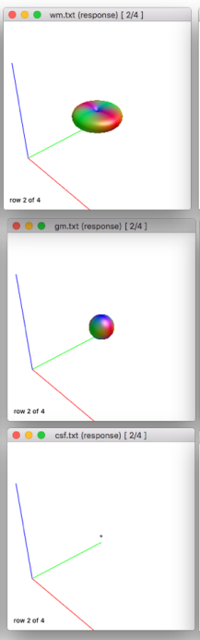
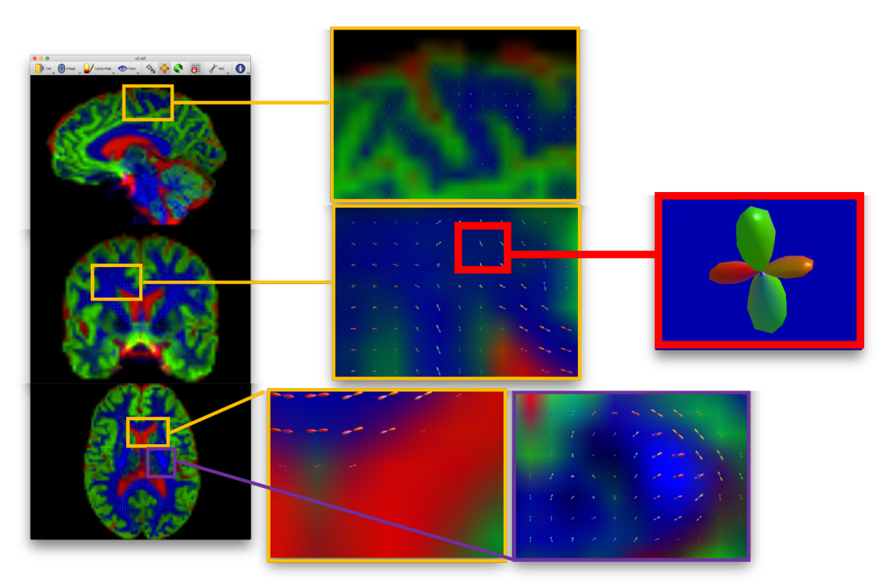
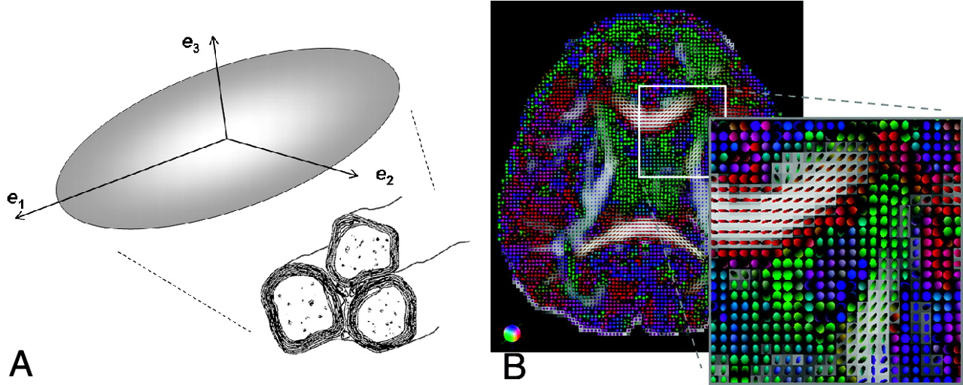
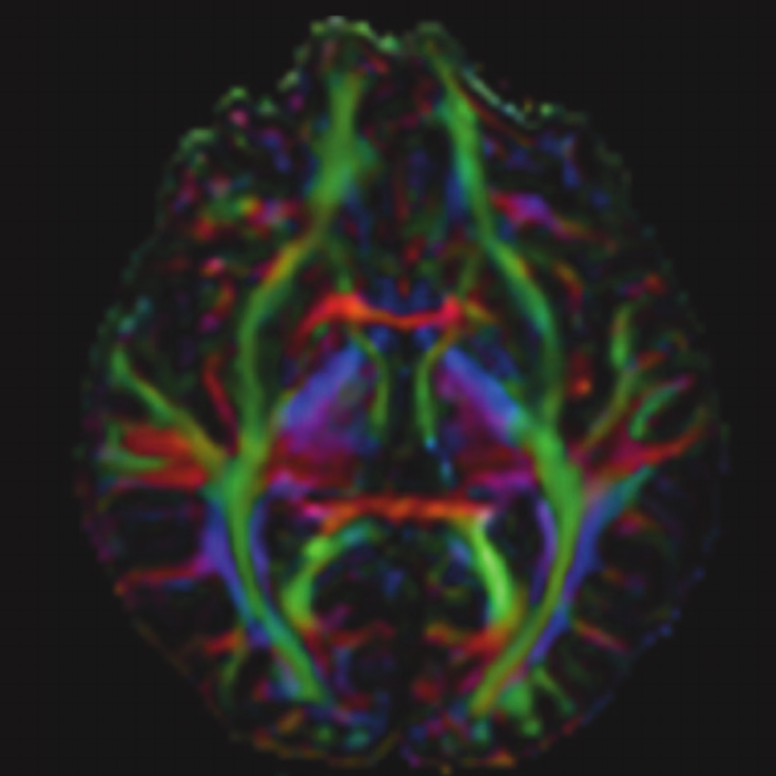

Tractography - Modelling/Reconstruction
Estimate different response functions for white matter (WM), gray matter (GM), and cerebrospinal fluid (CSF).
Response function estimation
In every voxel, estimate the orientation of all fibers crossing that voxel.
White matter
Grey matter
FOD Estimation
Normalisation
Correct for global intensity differences
(Crucial while performing group studies!)
Tensor estimation
FA map generation

Slide 24
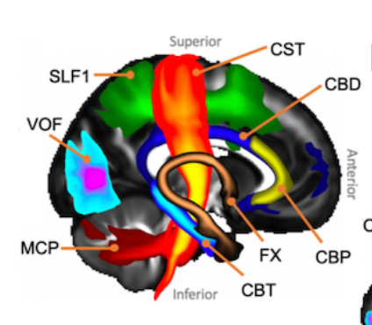
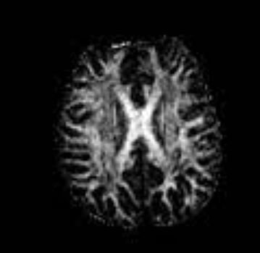
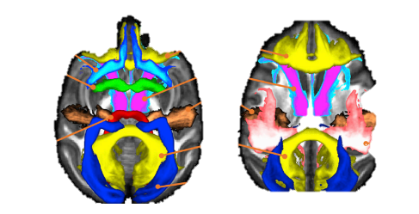

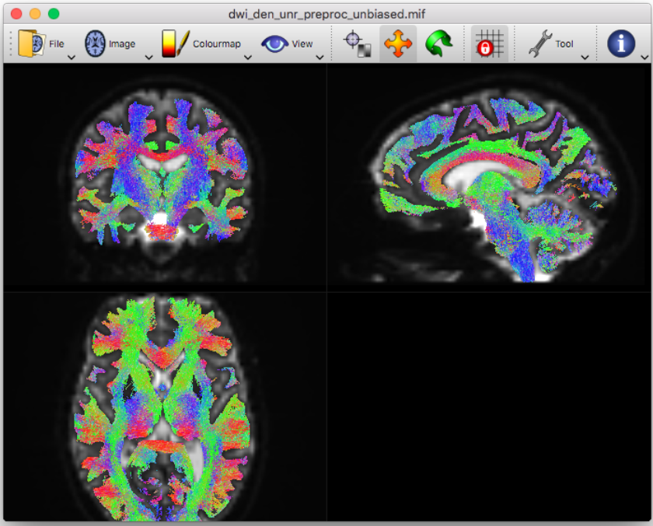
Tractography
Atlas selection
Co-registration
Xtract altas
Brings atlas to the subject space
FA map
(subject space)
Mask extraction from co-registered atlas
Probabilistic Tractography

Slide 25
Thank You

